Slide 1
Youth Participation in Politics
MGSC 310 Final
Nora Mirabal

Slide 2
Motivation
1
2
Advertising
Tour Planning
3
4
Projections
Budget

Slide 3
Original Data
ICPSR
Survey Collection
2013-2015
1033 Observations
508 Variables

Slide 4
Cleaning the Data
Subset data frame
Rename variables
Drop null values

Slide 5
Variables
Republican_rating
Democratic_rating
Age
Education_level
Gender
House_hold_size
Citzen_status
Work_status
Network_access
Netincome_cat
Region
Race

Slide 6
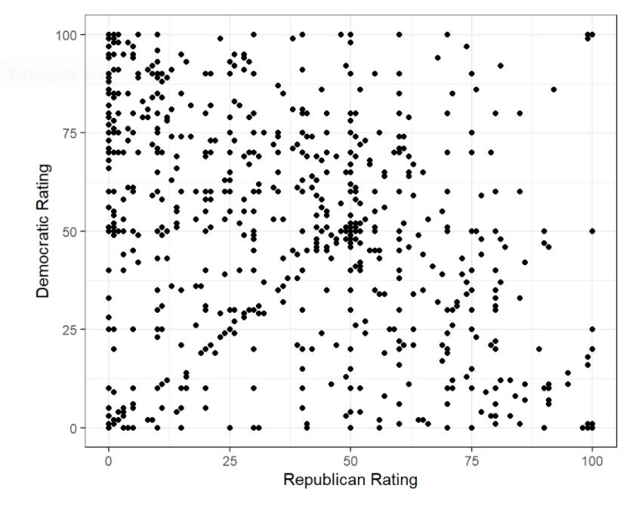

Slide 7
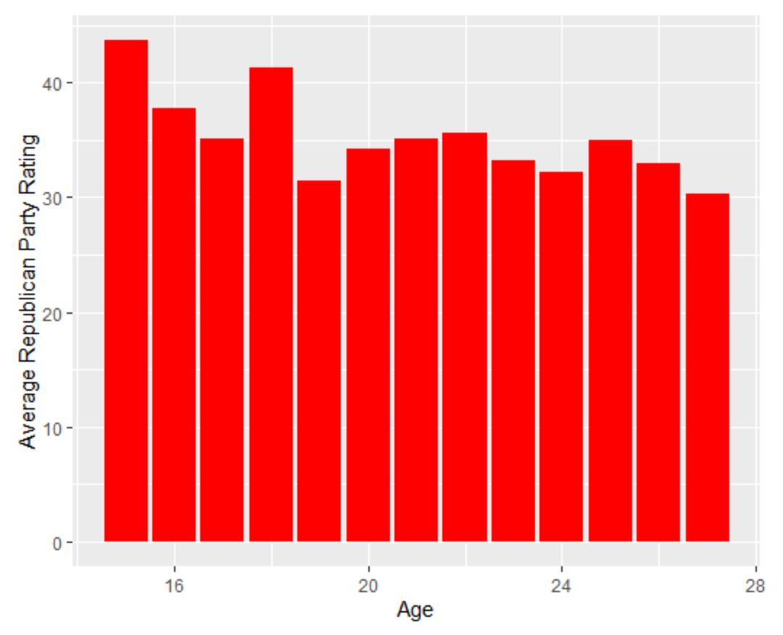
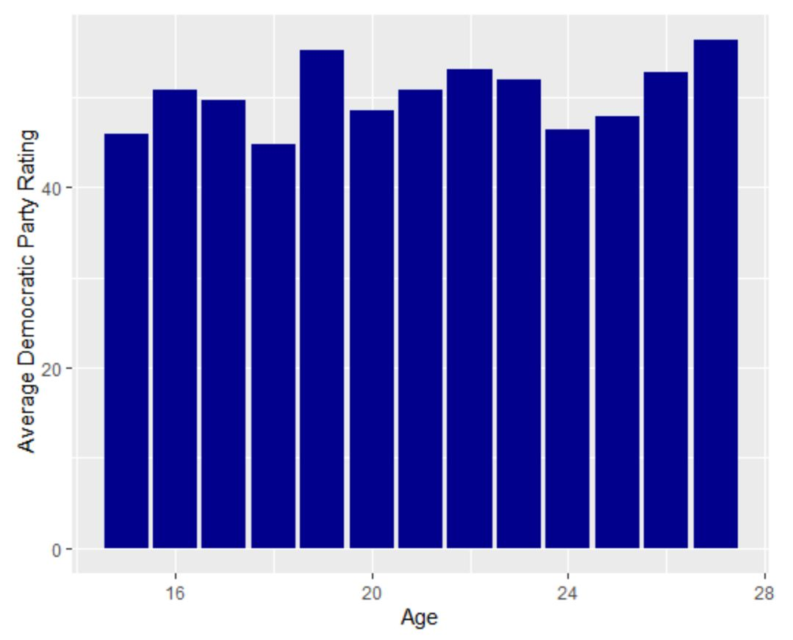
Age VS Average Party Rating

Slide 8
Can we predict someone’s rating of both the Democratic and Republican party based solely on their demographics?

Slide 9
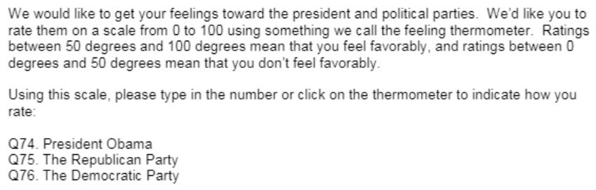

Slide 10
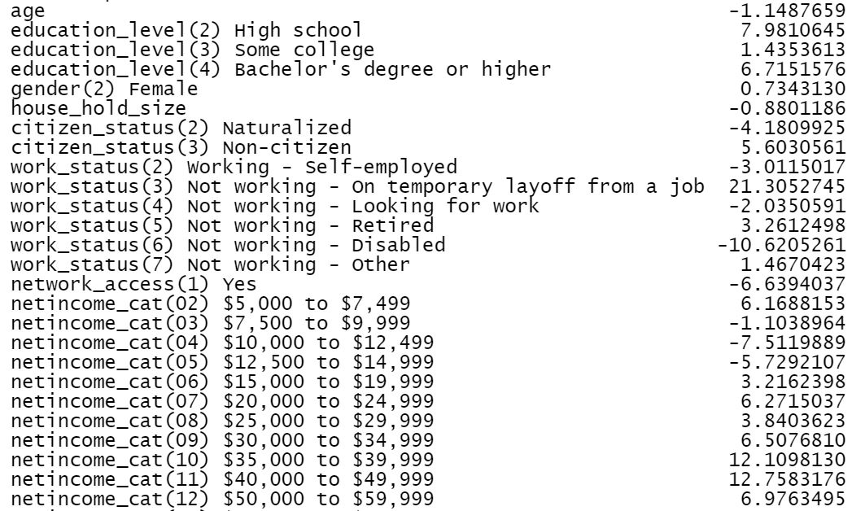
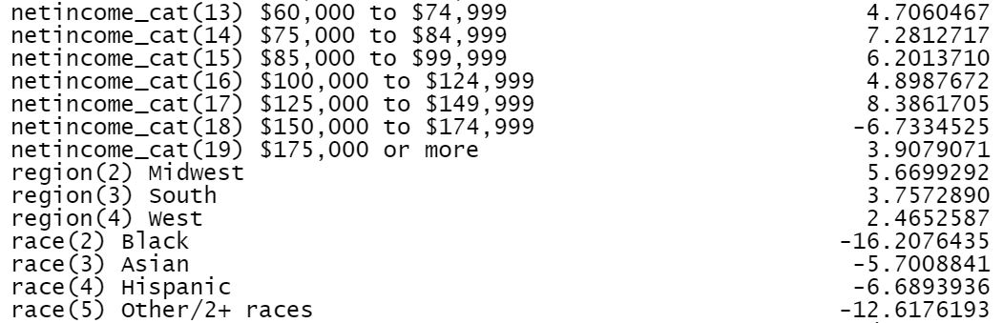
Republican Rating - Linear Regression
Train:
RMSE: 25.57
MAE: 21.39
Test:
RMSE: 27.88
MAE: 23.78

Slide 11
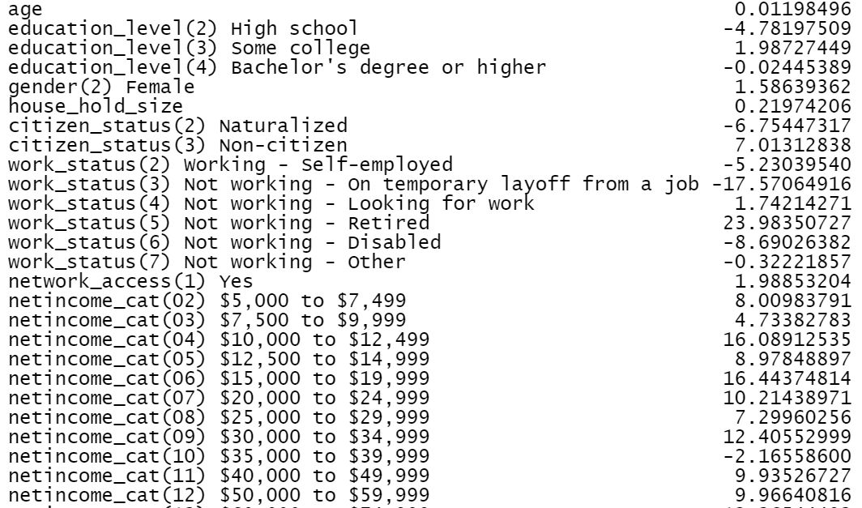

Democratic Rating - Linear Regression
Train:
RMSE: 26.42
MAE: 21.64
Test:
RMSE: 26.82
MAE: 22.24

Slide 12
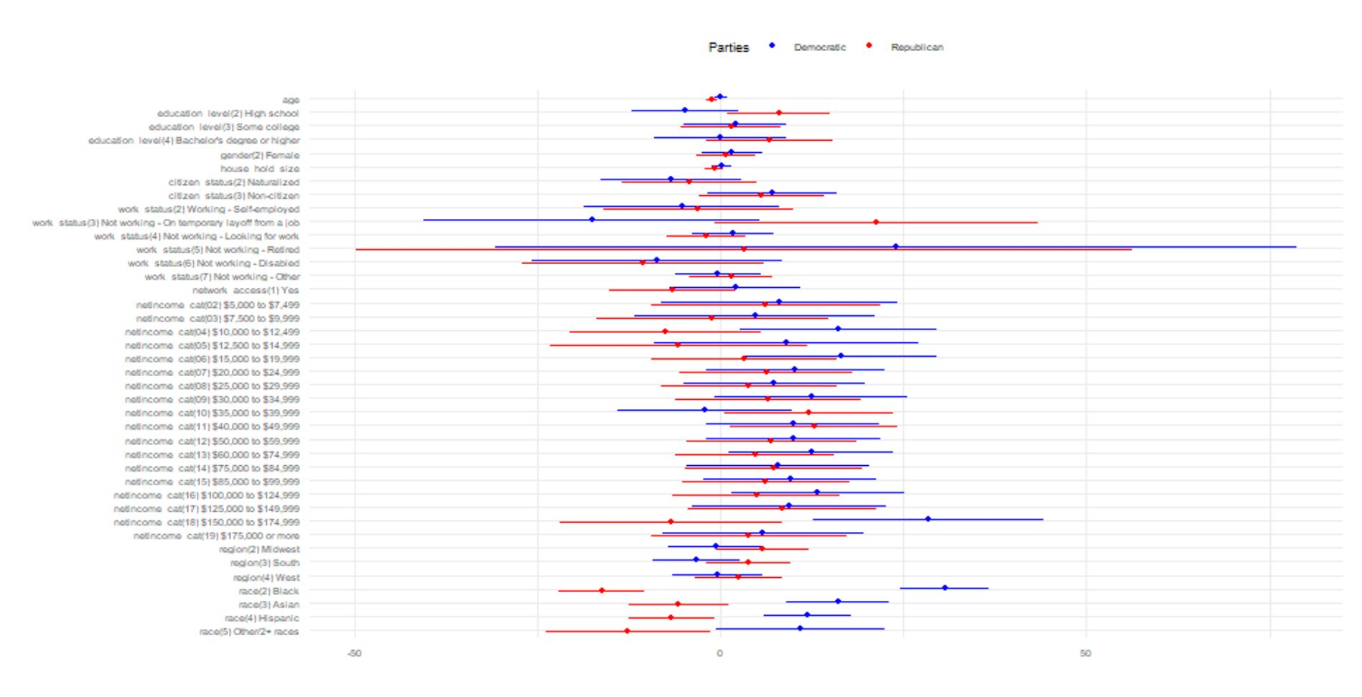

Slide 13
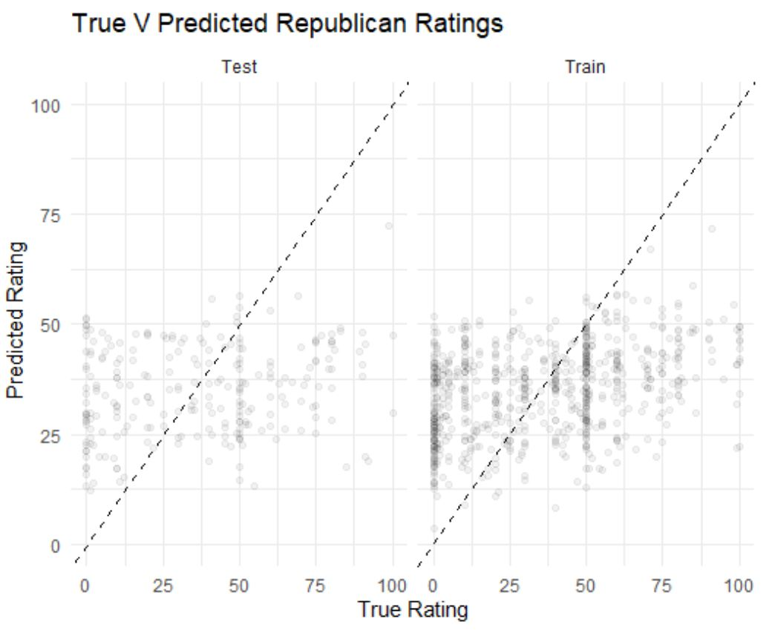
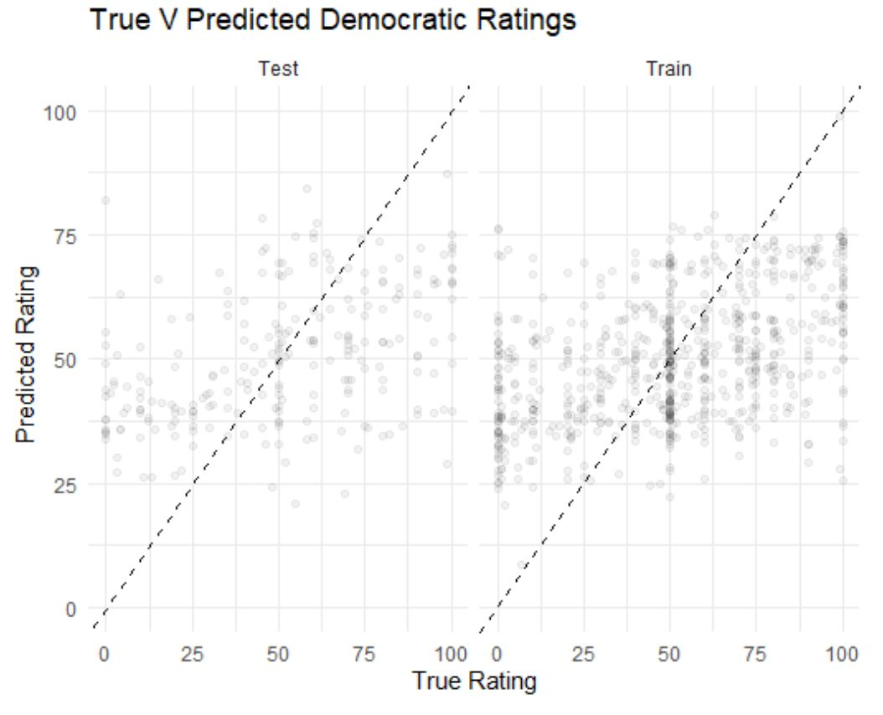
True V Predicted Rating Values

Slide 14
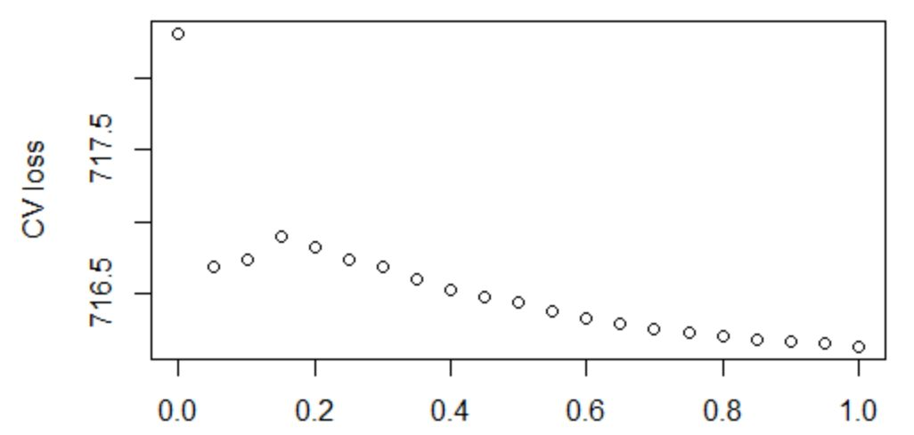
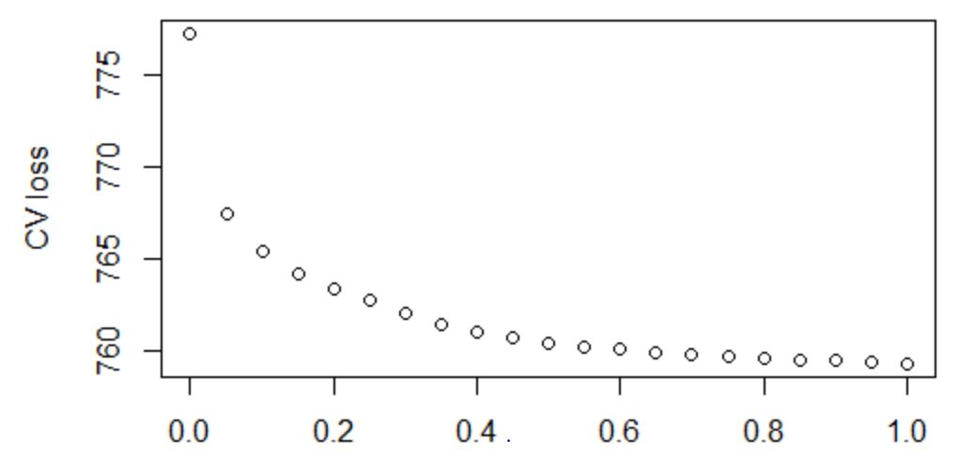
Ridge or Lasso?
Republican
Alpha: 1
Lambda.min: 1.48
Lambda.1se: 4.12
Democratic
Alpha: 1
Lambda.min: 1.50
Lambda.1se: 5.04

Slide 15
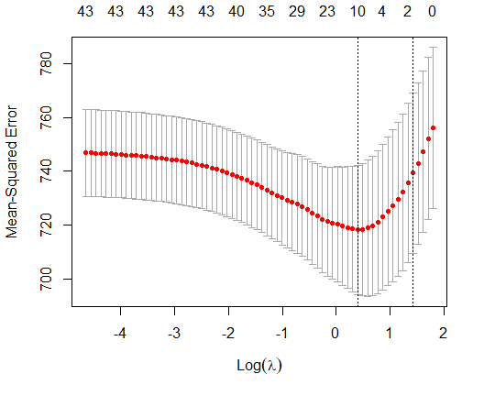
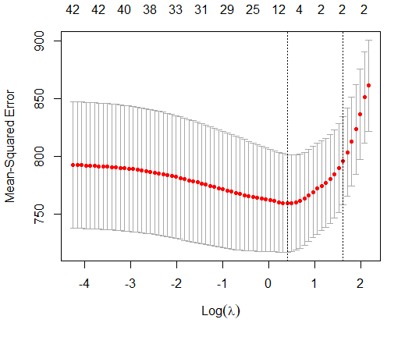
Republican Democratic

Slide 16
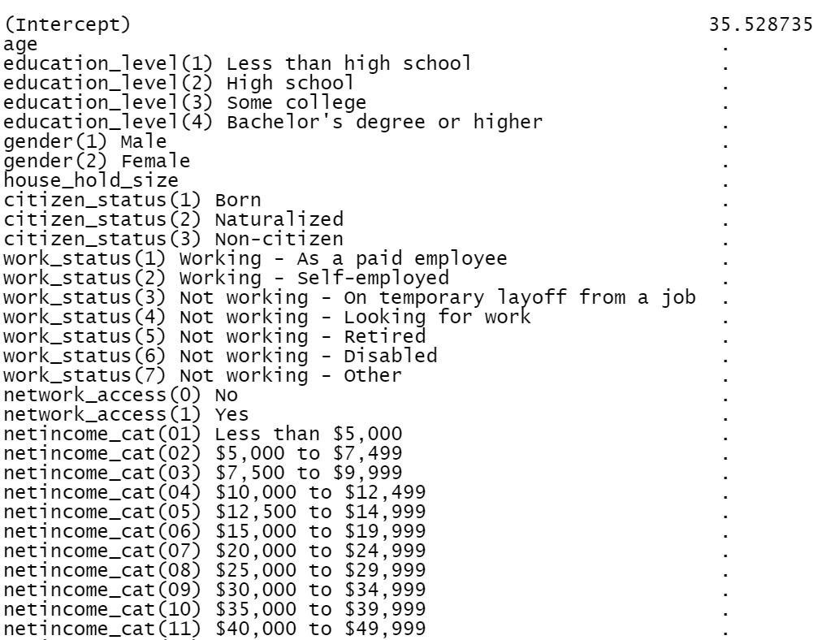
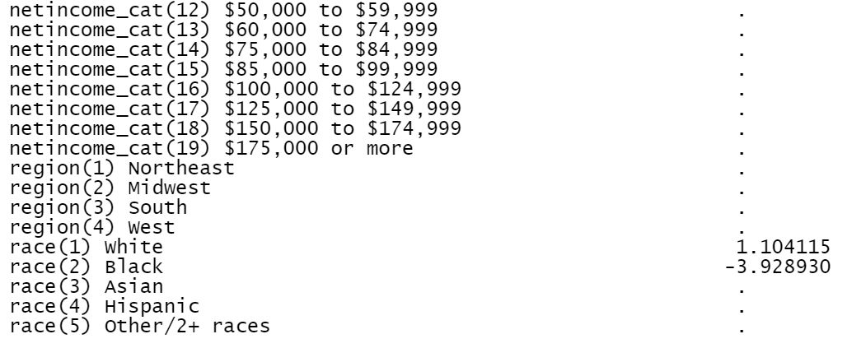
Republican Rating - Lasso
Train:
RMSE: 32.52
MAE: 27.04
Test:
RMSE: 32.47
MAE: 26.87

Slide 17
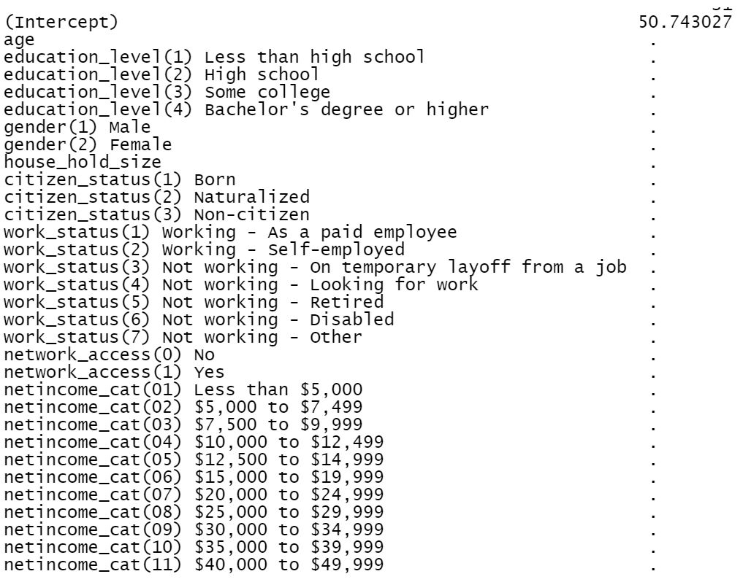
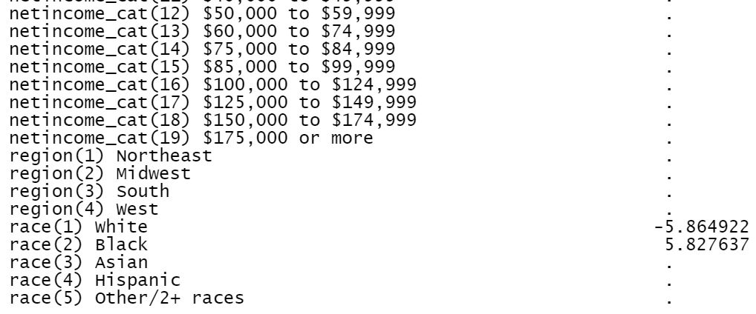
Democratic Rating - Lasso
Train:
RMSE: 28.05
MAE: 22.89
Test:
RMSE: 27.77
MAE: 22.96

Slide 18
Implementation
Too inaccurate for implementation
Needs higher accuracy for efficient use of budget

Slide 19
Limitations
Few Observations
Questionably random sample

